Slide 1

Core X-Y Printer Printer Training Guide
2026
The Vancouver Hack Space Society
1601 Venables St, Vancouver BC

Slide 2
Our Core X-Y Printers
Not Hackable.
Do not hack.
Do not attempt any fixes.
If something seems different, stop and post on #3dPrinting
Core X-Y Printer Training Guide
© The Vancouver Hackspace Society

Slide 3
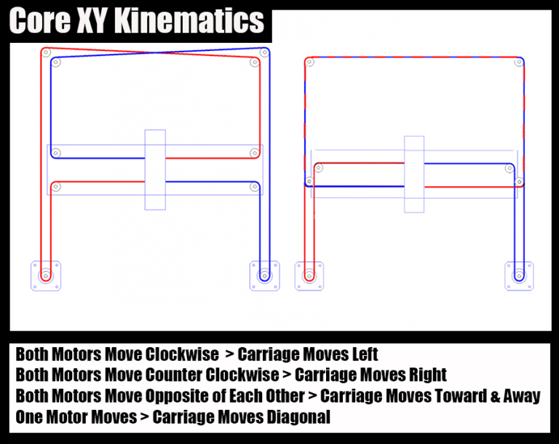
What is Core X-Y Printer
Core X-Y Printer Training Guide
© The Vancouver Hackspace Society

Slide 4
The Voron Project
We build space shuttles with gardening tools so anyone can have a space shuttle of their own.
The original goal of the VORON project, back in 2015, was to create a no-compromise 3D printer that was fun to assemble and a joy to use. It had to be quiet, clean, pretty, and continue to operate 24 hours a day without requiring constant fiddling. In short a true home micro-manufacturing machine without a hefty price tag.
Core X-Y Printer Training Guide
© The Vancouver Hackspace Society

Slide 5

Core X-Y Printer Training Guide
© The Vancouver Hackspace Society

Slide 6
Advantages
Core X-Y Printer Training Guide
© The Vancouver Hackspace Society

Slide 7
Dangers + Responsibilities
Core X-Y Printer Training Guide
© The Vancouver Hackspace Society

Slide 8
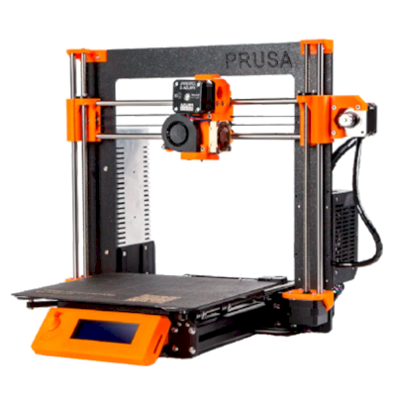
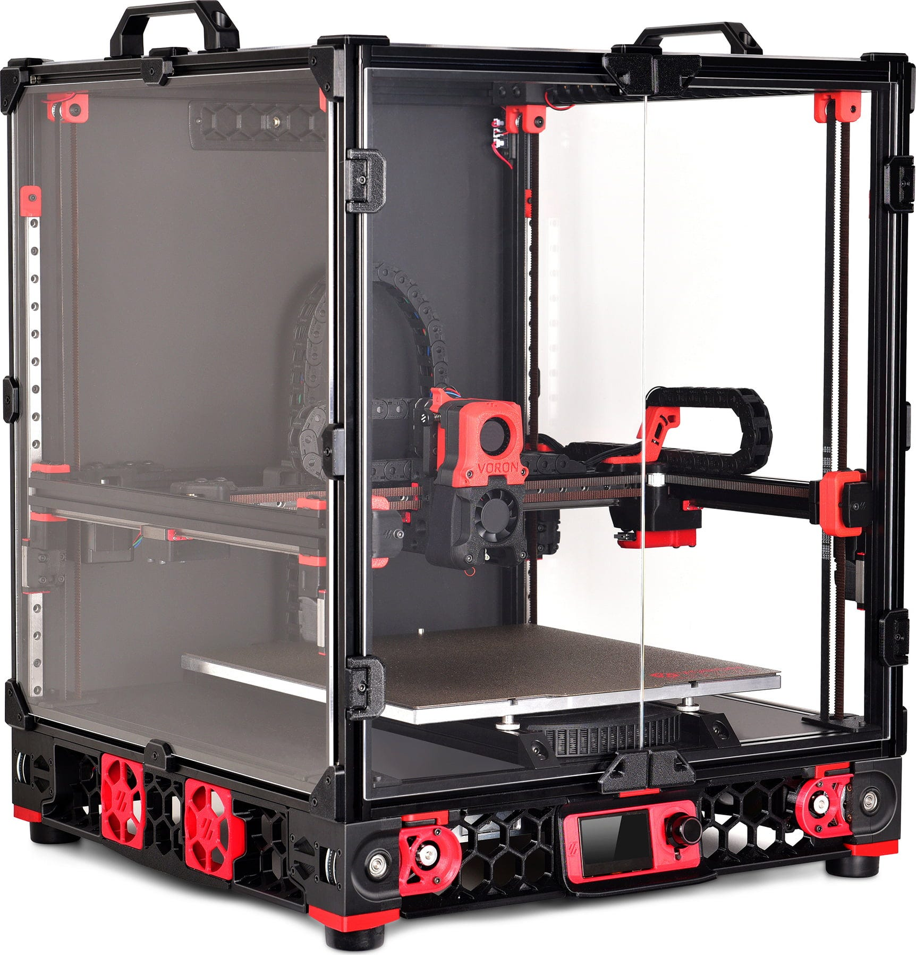
vs
Core X-Y Printer Training Guide
© The Vancouver Hackspace Society

Slide 9
Prepare the printer
Is the build plate clean? Wash and dry it anyway!
Does everything look okay? Any fasters undone? Flying gantries don’t like to be touched!
Filament HAS to be cut at 45 degrees
Core X-Y Printer Training Guide
© The Vancouver Hackspace Society

Slide 10

Bed is Lava! Leave it alone
Core X-Y Printer Training Guide
© The Vancouver Hackspace Society

Slide 11

Verify the source!
Core X-Y Printer Training Guide
© The Vancouver Hackspace Society

Slide 12
Download Orca Profiles
Core X-Y Printer Training Guide
© The Vancouver Hackspace Society

Slide 13
Introduction to Orca:
Printer Profiles
Filament Profiles
Print Profiles (Different from printer profiles)
Core X-Y Printer Training Guide
© The Vancouver Hackspace Society

Slide 14
Prepare Your File!
Core X-Y Printer Training Guide
© The Vancouver Hackspace Society

Slide 15
Basic Printer Operations:
WebUI
Incognito Mode
NOMOS Credentials
Core X-Y Printer Training Guide
© The Vancouver Hackspace Society

Slide 16

Basic Printer Operations:
Emergency Stop
Homing
Filament load/ unload
Core X-Y Printer Training Guide
© The Vancouver Hackspace Society

Slide 17

Chamber Temperature
When to heat soak vs leave the door open
Core X-Y Printer Training Guide
© The Vancouver Hackspace Society

Slide 18
Start your print!
Core X-Y Printer Training Guide
© The Vancouver Hackspace Society

Slide 19
Object Exclusion
Core X-Y Printer Training Guide
© The Vancouver Hackspace Society

Slide 20
What not to mess with and why
Core X-Y Printer Training Guide
© The Vancouver Hackspace Society

Slide 21
What not to mess with and why
Core X-Y Printer Training Guide
© The Vancouver Hackspace Society

Slide 22
While it prints…
Core X-Y Printer Training Guide
© The Vancouver Hackspace Society

Slide 23
Calibrating Filaments
Core X-Y Printer Training Guide
© The Vancouver Hackspace Society

Slide 24
Temperature Tower
Pressure Advance
Flow Ratio
Core X-Y Printer Training Guide
© The Vancouver Hackspace Society

Slide 25
Clean up!
Core X-Y Printer Training Guide
© The Vancouver Hackspace Society

